Slide 1

Presentation on
Blood Donation Management System

Slide 2
Presented By
Supervised By
Tunazzinur Rahman Kabbo
ID: 19202103268
Md. Zobayer Hasan Nayem
ID: 19202103274
Afrina Akter Mim
ID: 19202103310
Sagor Kumar Saha
ID: 19202103423
Intake: 44
Section: 8
Sweety Lima
Lecturer
Department of Computer Science and Engineering,
Bangladesh University of Business and Technology (BUBT)

Slide 3
1
Introduction
2
Problem Definition
3
Objective
PROJECT OUTLINE
4
System Requirements
5
UML Diagram
6
Project Features
7
Conclusion
8
Future Work

Slide 4
Introduction

Slide 5
Introduction
Blood donation is a small act of kindness that does great and big wonders.
In this project, we tried to make a web application for blood donor.
This application save the regular blood donor information and make them available for its blood requesters.
The donors information is saved in database and can be done any operation by the admin only.

Slide 6
Problem
Definition

Slide 7
Problem Definition
Goal
1
To help the blood requesters so that they can easily find their necessary blood group within a short time.
Operation
2
Saves the donor details by getting them voluntarily registered so that blood requester can easily search necessary blood group
Work
3
Three types of user can use this web app, they are blood requester, donor and admin.
4
Lacking
Here, only admin has accessibility to make change in the blood bank database.

Slide 8
Objectives

Slide 9



Objectives
Goal
To help the people in need of blood by storing the users and donors information in two different fields and by using their information depending on the demand.
This web application is connected to a database that stores all the data and only the admin can make changes on the table without visiting the database manually.

Slide 10
System Requirements

Slide 11
System Requirements
Hardware
Desktop PC or Laptop with Windows 10 installed
Database
MySQL
Frontend
Software
Language: HTML, CSS, JavaScript
XAMPP and Brackets
Browser
Backend
Google Chrome, Mozilla Firefox, Opera etc
Language: PHP

Slide 12
UML Diagram

Slide 13
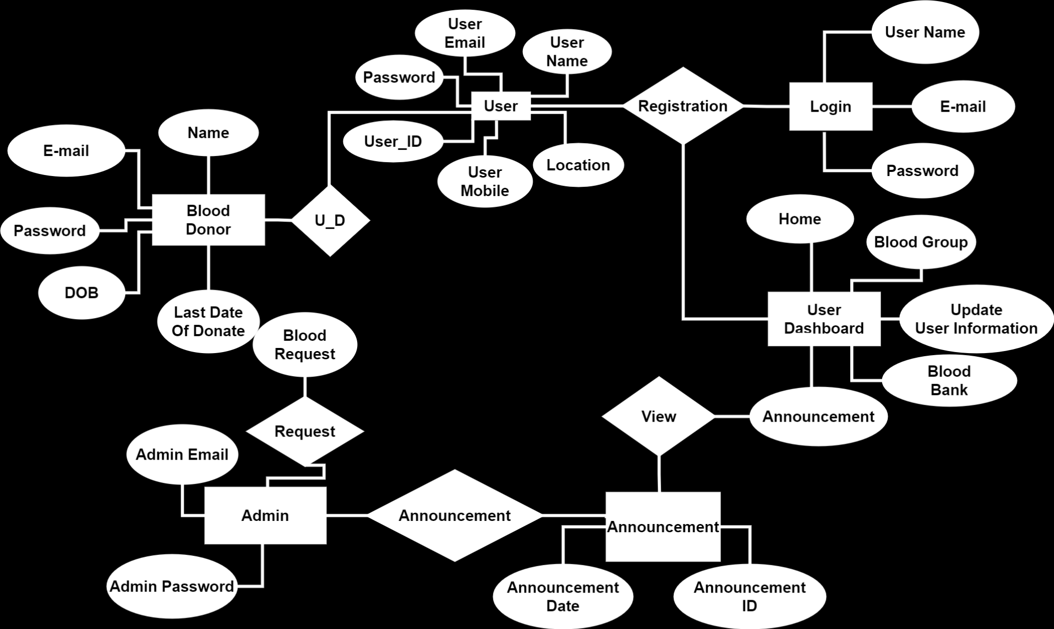
ER Diagram
Figure: ER Diagram for Blood Donation Management System

Slide 14
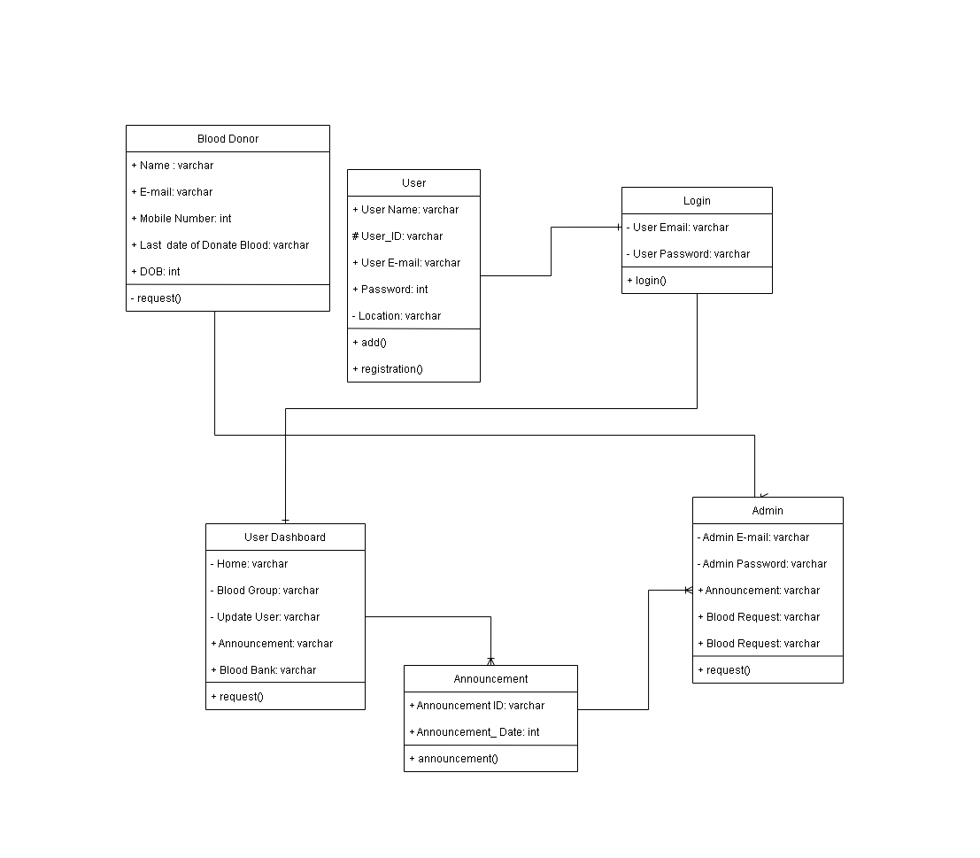
Class Diagram
Classes are represented with boxes that contain three compartments:
Class name
Attribute name with datatype
Method
Figure: Class Diagram for Blood Donation Management System

Slide 15
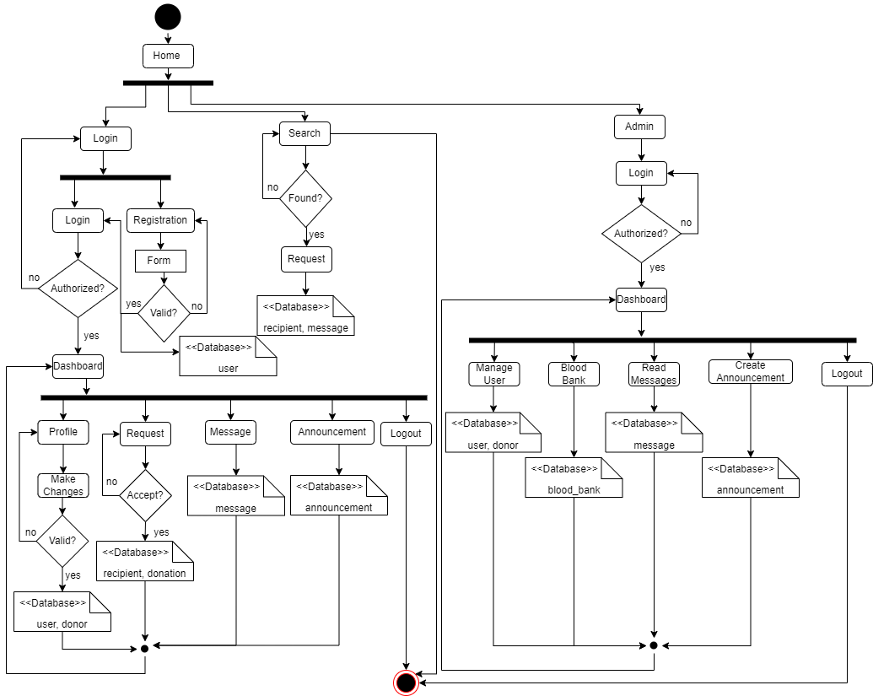
Activity Diagram
Activity diagram components are:
Starting State
Action State
Control Flow
Decision Node
Fork
Join
End State
Figure: Activity Diagram for Blood Donation Management System

Slide 16
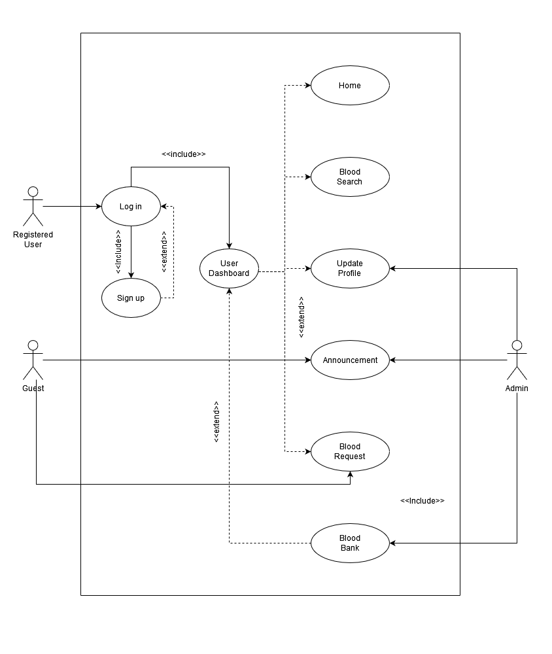
Use case Diagram
Use case diagram components are:
Actor
Symbol
Line
Figure: Use Case Diagram for Blood Donation Management System

Slide 17
Project Features

Slide 18
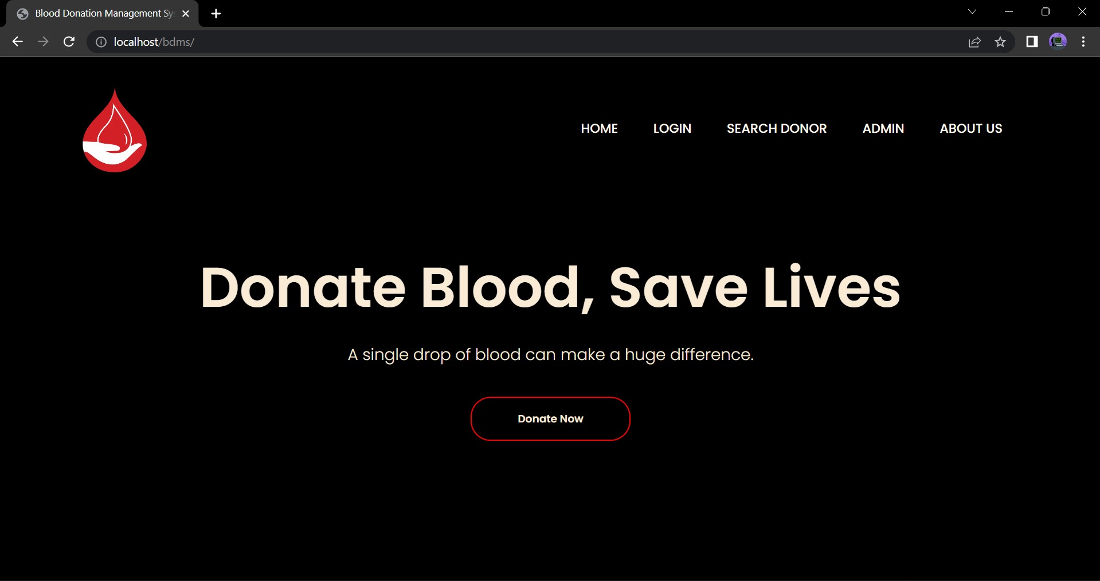
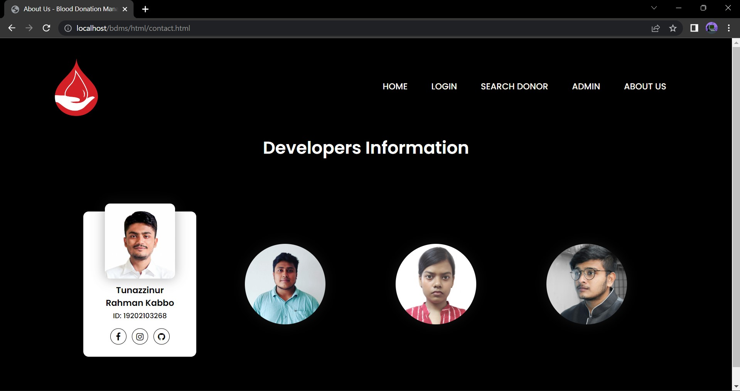
Project Features
Home Page:
About Page:

Slide 19
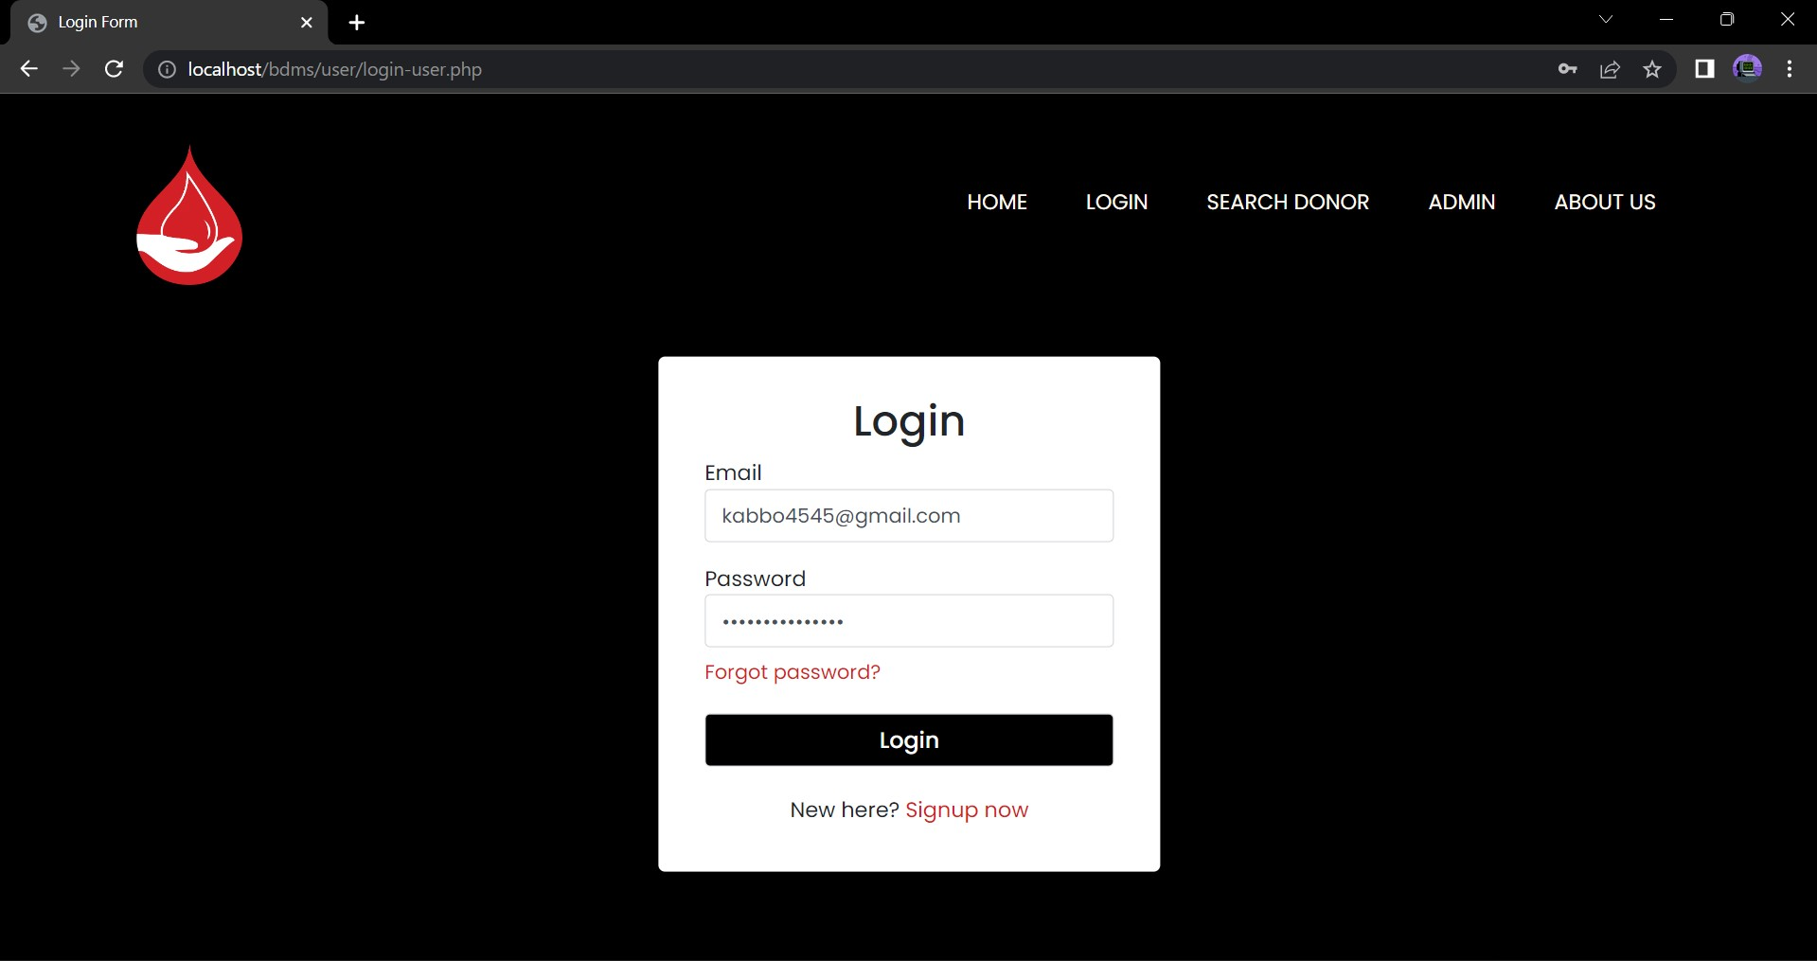
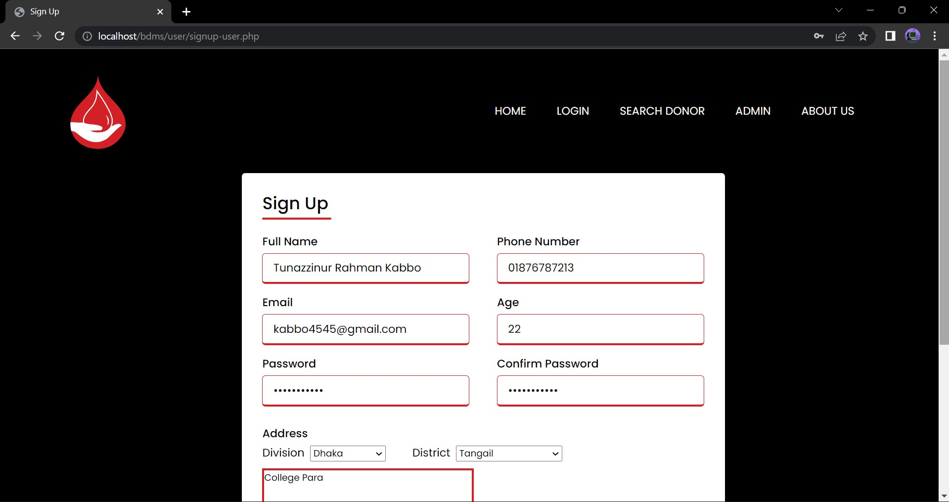
Project Features
Register for user:
Login for user:

Slide 20
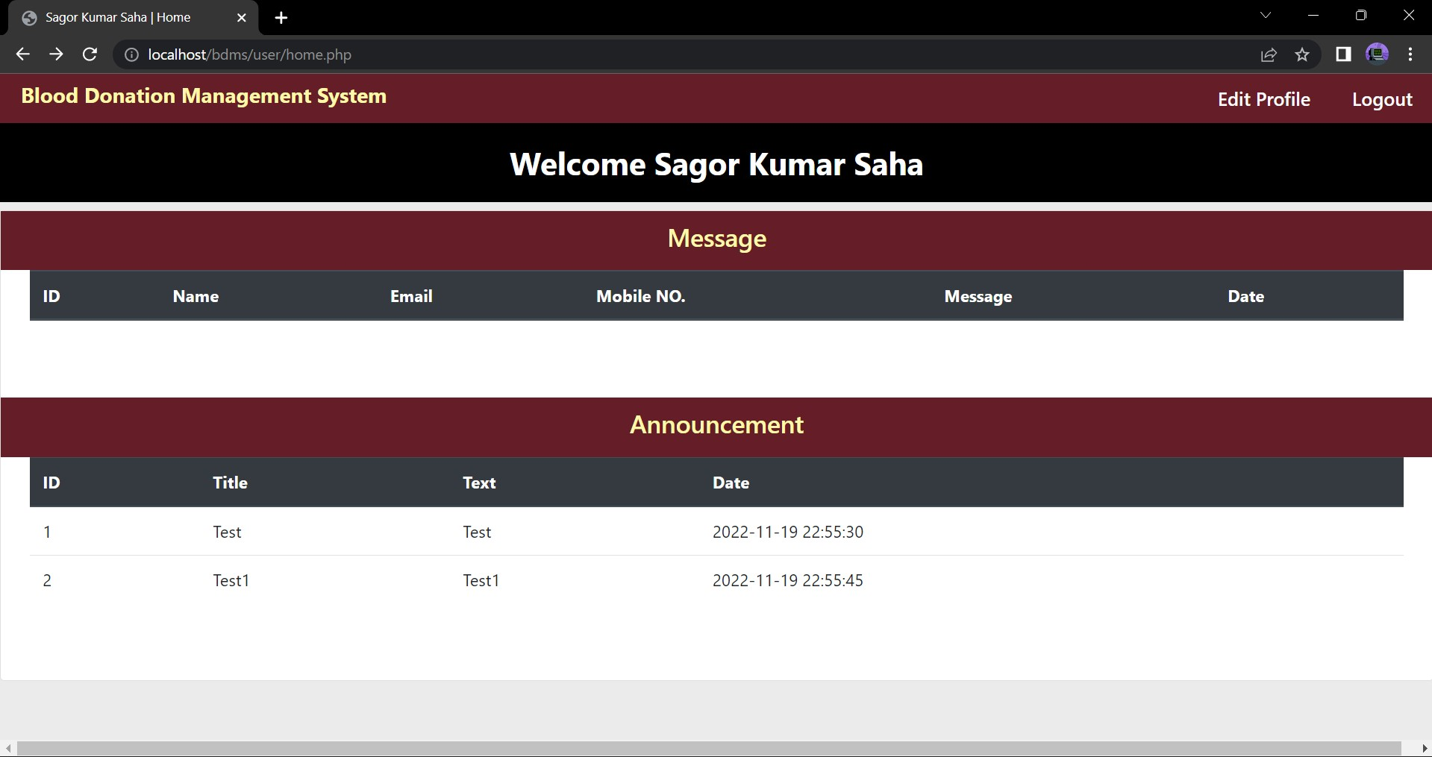
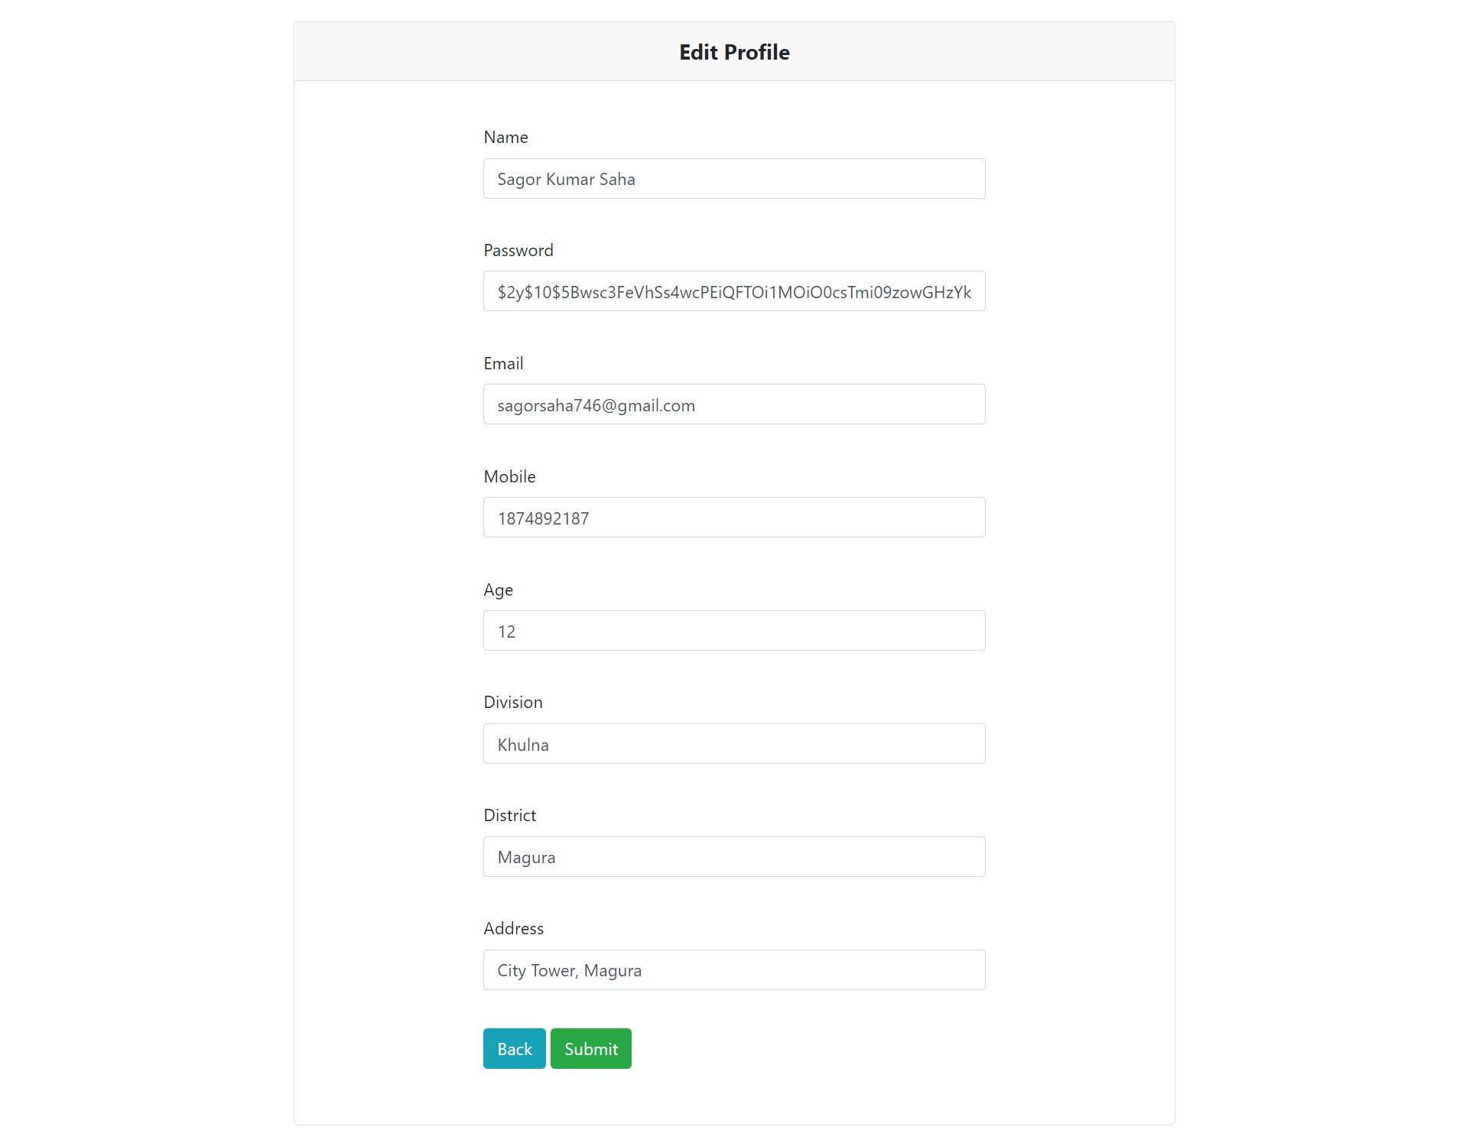
Project Features
User Dashboard:
Profile Edit:

Slide 21
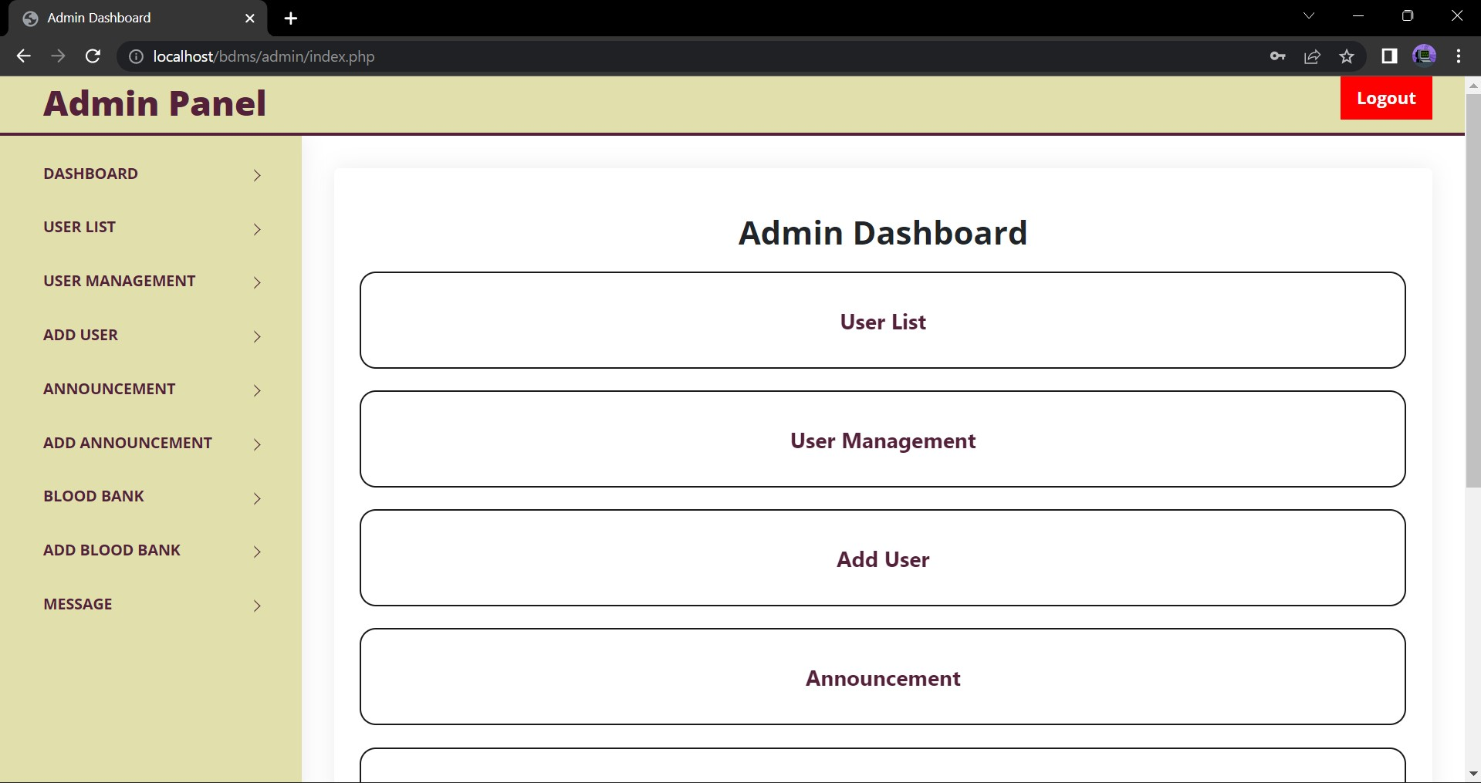
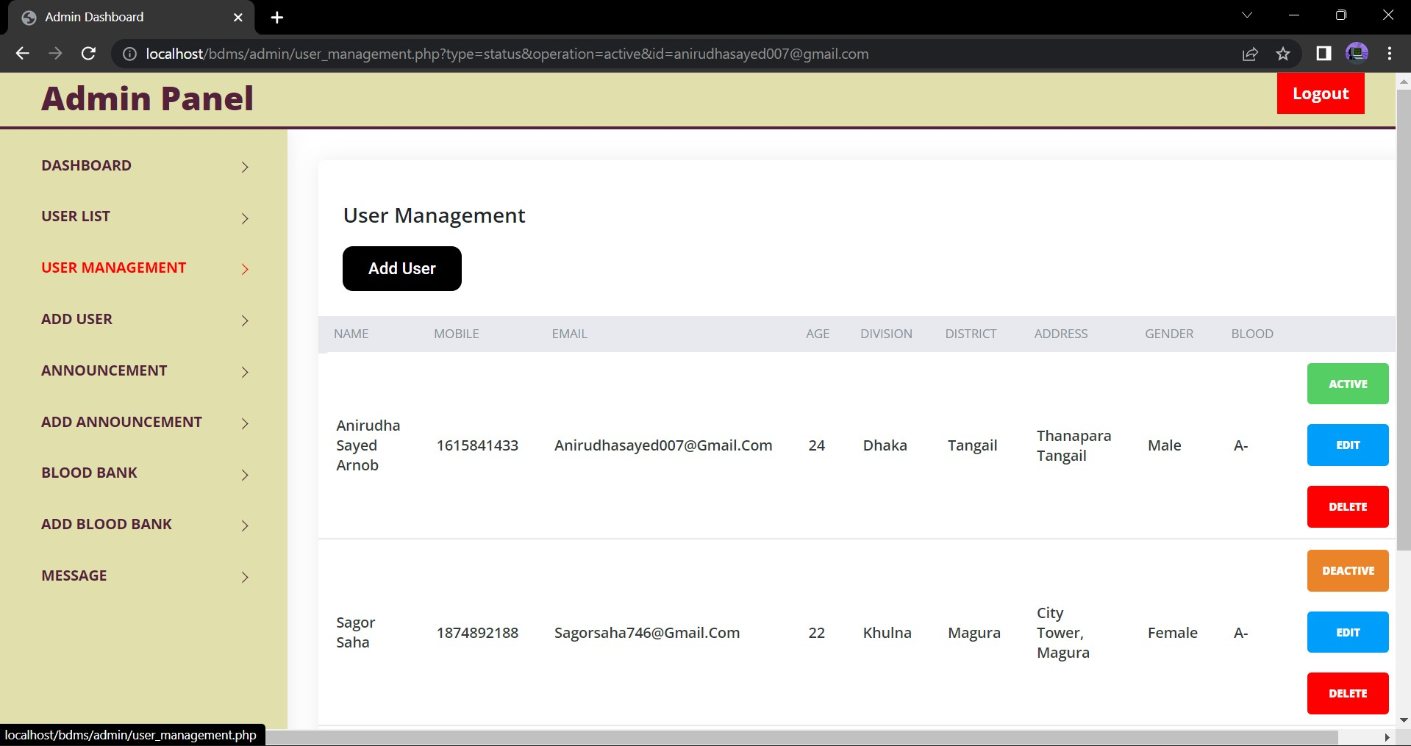
Project Features
Admin Dashboard
User Management

Slide 22
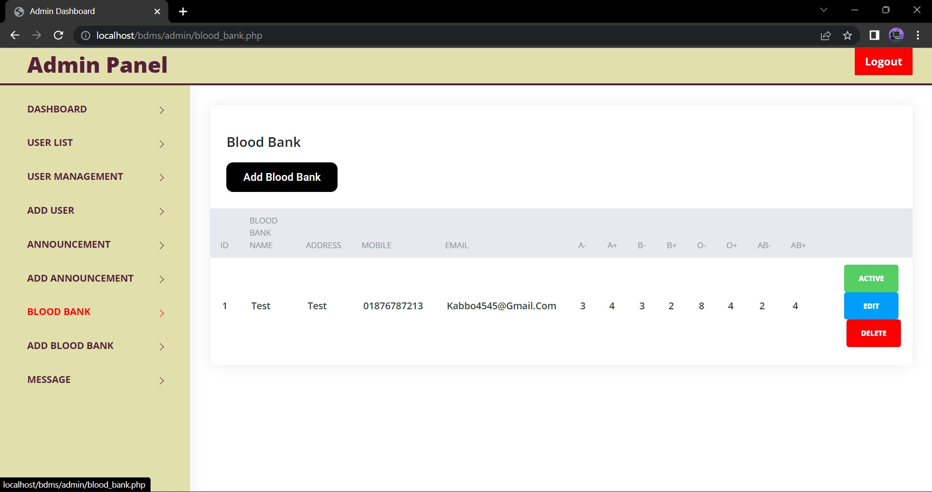
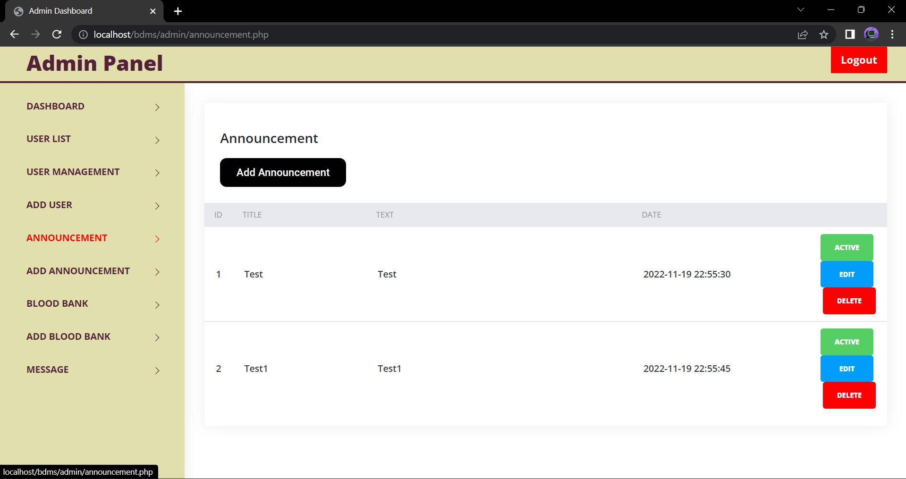
Project Features
Blood Bank
Announcement

Slide 23
Future Work

Slide 24
Future Work
Blood Camp Arranging Option
Report Generating Function
Collaboration with Blood Bank

Slide 25
Conclusion

Slide 26
Conclusion
A simple web based project using PHP.
Has couple a number of table to store data of and CRUD operation is done in different fields.
Secure password with bcrypt algorithm and user verification with OTP.

Slide 27
THANK YOU!

